Slide 1
Employee Attrition
Forecasting
Here is where your presentation begins
Bùi Thị Lan Anh - Nhóm 3 - DA18

Slide 2
Table of contents
01
02
03
04
Dataset Introduction
Data Preparation
Model Building
Prediction & Evaluation

Slide 3
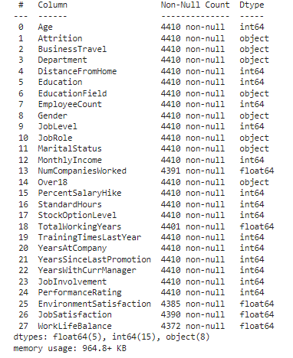
0.1 Dataset Introduction
The dataset is obtained from Kaggle
This data is about the HR attrition of a company with 4000 employees. Annually 15% of staff quit job.
This study will combine 3 dataset: general, employee, and manager, with 4410 rows, 28 columns.
The label of the dataset is “Attrition” meaning whether the employee quit the job or not.
The purpose of the forecasting study is to calculate the probability of attrition with classification models.

Slide 4
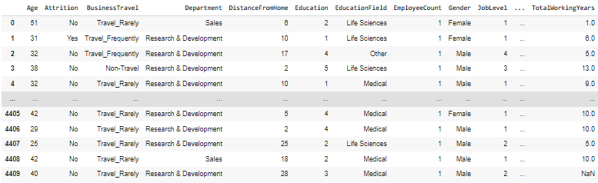
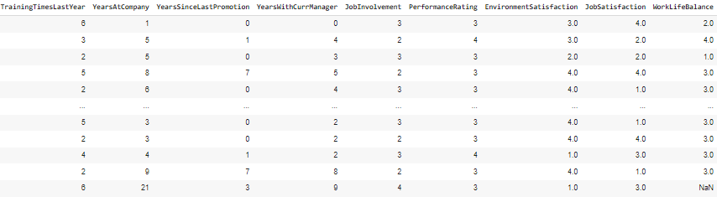
02. Data Preparation
Because 3 partial datasets have several Nan values, and some unnecessary column such as:
'EmployeeCount',
'Over18',
'PercentSalaryHike',
'StandardHours',
'StockOptionLevel'
⇒ Replace Nan values with Mean of each column and dropped above columns.
⇒ Encode the data into number 1,2,3,4 as float type

Slide 5
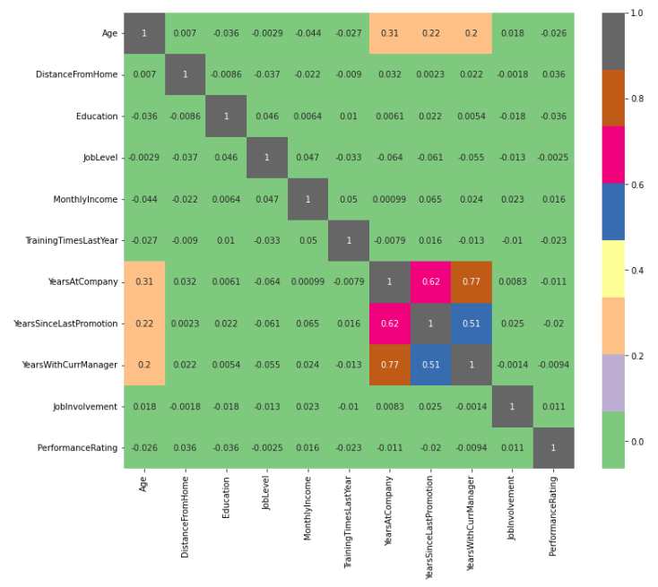
Plot the correlation graph between variables.
Saturn
Saturn is a gas giant and has several rings. This planet is composed mostly of hydrogen and helium. It’s the sixth planet from the Sun and was named after a Roman god

Slide 6
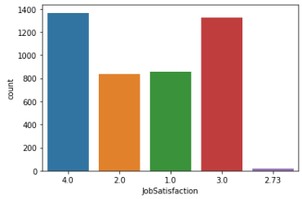
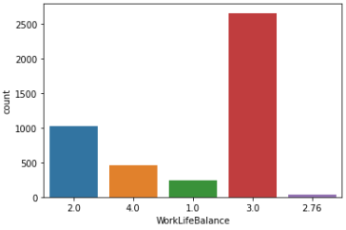
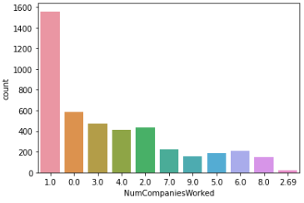
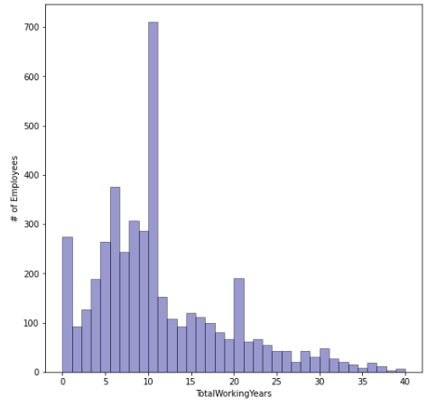
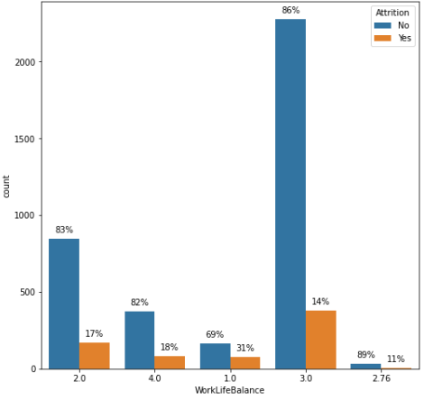
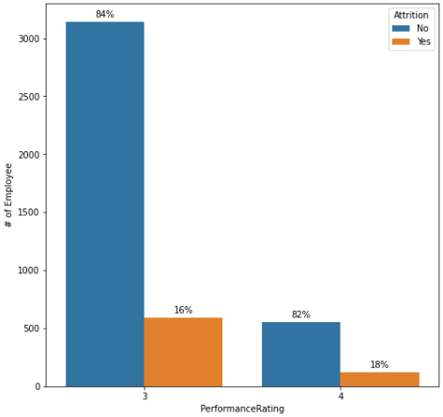
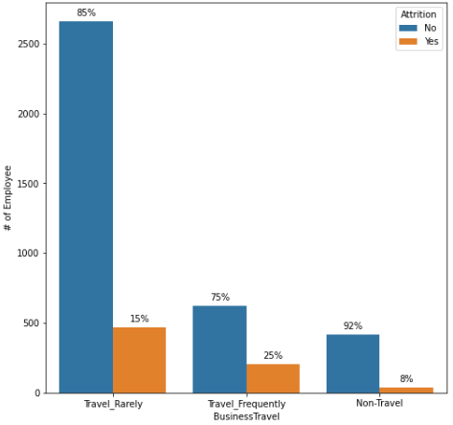
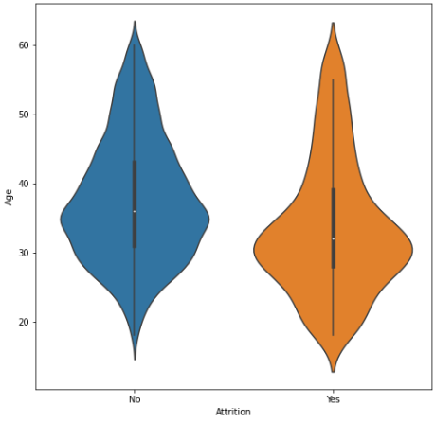
Job satisfaction mostly reach point 3.0 and 4.0
‘Work life balance’ at point 3.0 has the highest yes ‘attrition’
All employee vote job performance at point 3.0 and 4.0
Most employees quit job around the age of 30

Slide 7
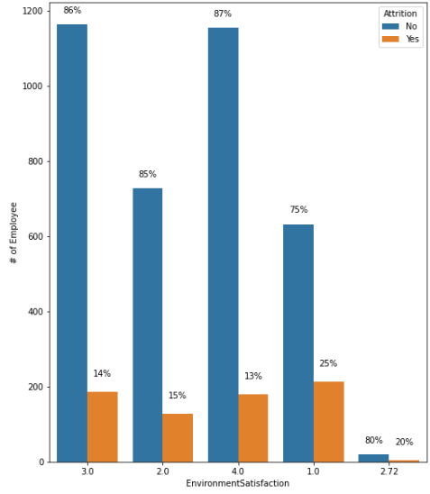
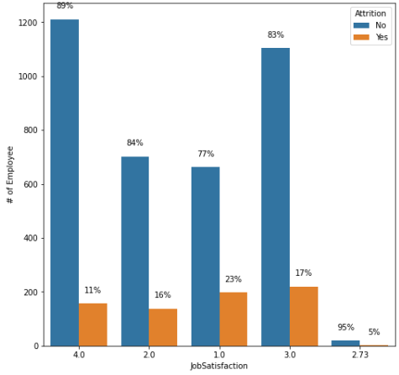
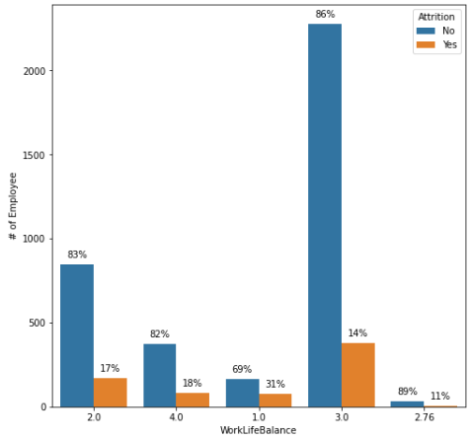
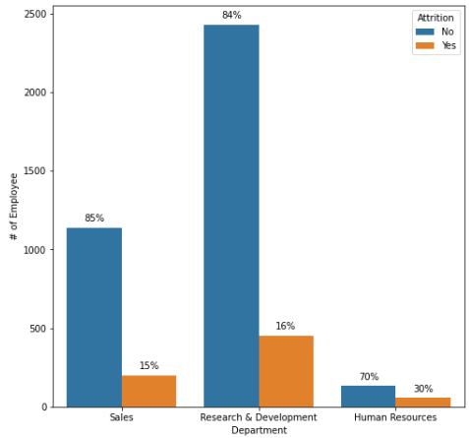
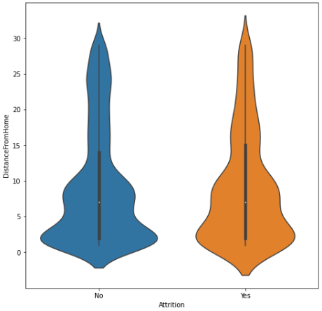
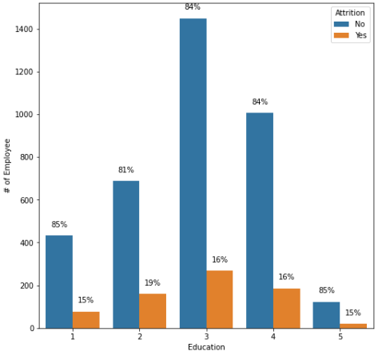
Both ‘environment satisfaction’ and ‘job satisfaction’ have the lowest percentage of attrition ( abt 20 staff)
About ‘Department’, employees mainly work in Sales and RnD dept, with staff of RnD dept have the highest chance of attrition (abt figure), but HR has the highest attrition within the Dept
‘Education’ at level 3 have both highest point of yes and no ‘attrition’

Slide 8
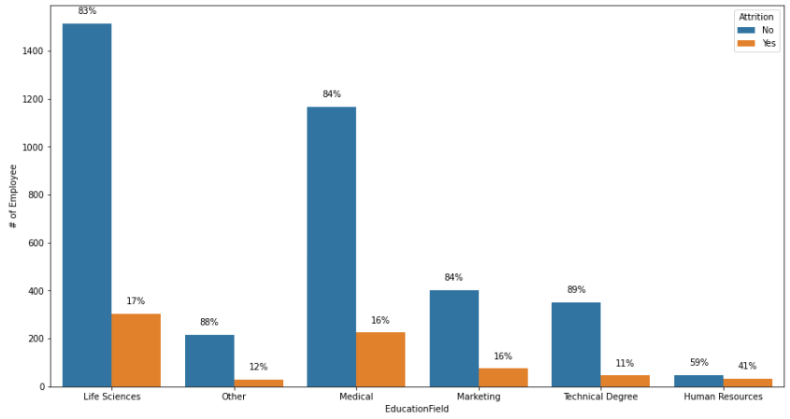
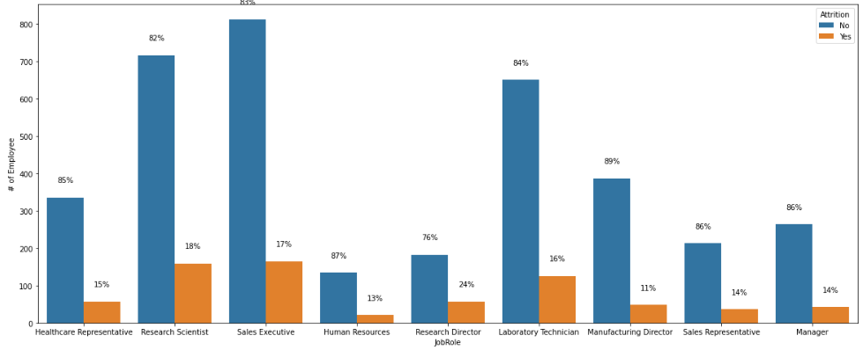
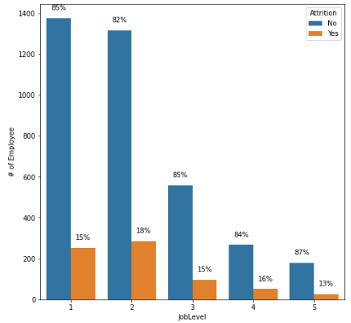
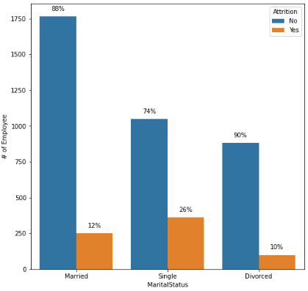
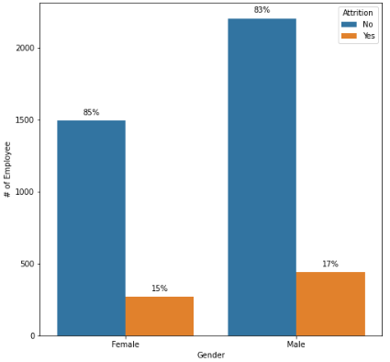
‘Education field’ - HR has the lowest figure (abt 100 totally) but 41% of them quit the job
In ‘Job role’ item, around 15% of the staff quit the job.
Most staff do the role as Research Scientist, Sales Executive, and Laboratory Technician
In ‘Job level’, staff work at level 1,2. They are the two level have the highest yes ‘attrition’ number
In ‘Job level’, staff work at level 1,2. They are the two level have the highest yes ‘attrition’ number
Most employees are male
Both genders have attrition percentage around 15%

Slide 9
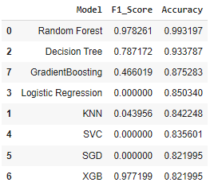
03. Model Building
After preprocessing data, build 7 models to predict.
Random Forest has the highest accuracy - 0.993, to be the most predictable model for this dataset.

Slide 10
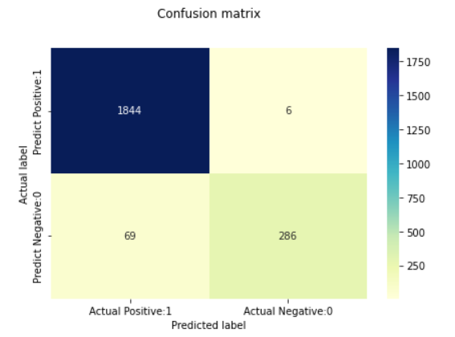
03. Prediction & Evaluation
True Positives(TP) = 1844
True Negatives(TN) = 286
False Positives(FP) = 6
False Negatives(FN) = 69
Attrition - ‘Yes’ = 1
Attrition - ‘No’ = 0

Slide 11
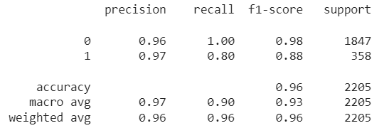
Attrition = 0 and Attrition = 1 have very high f1-score, 0.98 and 0.88.
This means the predictive ability of the model is quite good.

Slide 12
Thanks!
Do you have any questions?

